Slide 1
ETL service
Task 6

Slide 2
Product description
ETL service for private data cleansing Data quality and availability is important for applications running in the framework. The framework defines so-called data modules stored on S3 or in a RDBMS. A data module is described by a json-ld compatible metadata, a collection protocol and the versioned data. The ETL service would extract data from internal corporate systems, cleanse, merge, anonymize, transform the data and upload it to a new version of a data module. Then the module can be used by machine learning applications deployed on the framework.
Team: Anoshenko Daniil, Rogoza Kirill, Sergey Rogachev, Pham Manh, Denune Pravira
Repo: https://github.com/Neovodoo/ETL
Report: a link to this slides within project repo/doc storage

Slide 3



Use case diagram
Key use cases:
Service integration
Service configuration
Change service setting
Logs
Interaction with ETL jobs
Interaction with Datasets
Adding script to ETL
Initial roles management
Permission management
Summary reports
Text description of the use cases + diagrams: <Task6 folder in project repo>

Slide 4
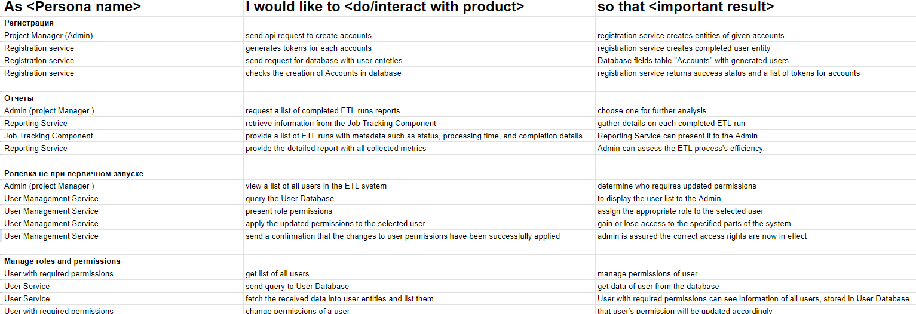
Use case text description
Text description of the use cases + diagrams: <Task6 folder in project repo>

Slide 5
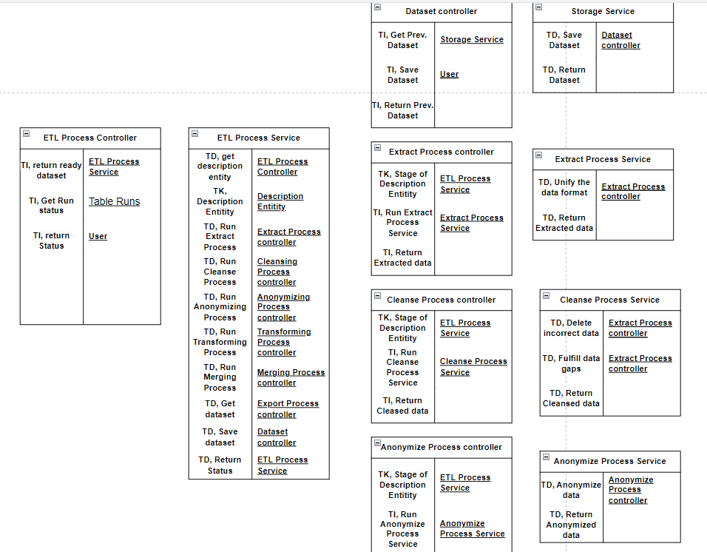
Interaction analysis

Slide 6
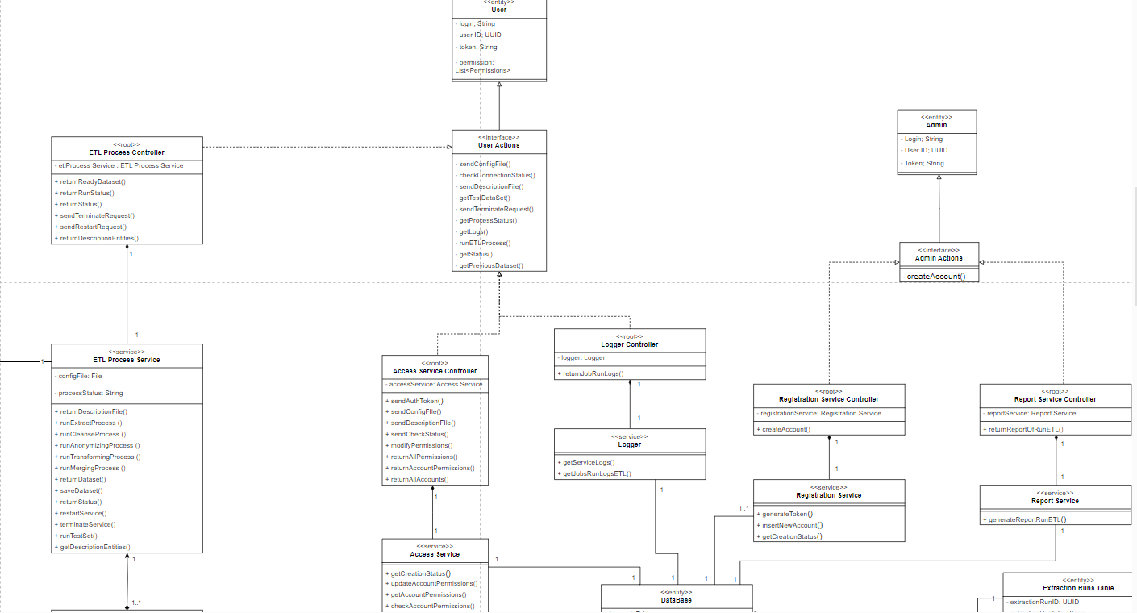
Updated class diagram

